Slide 1
Reincarnation
Why do we come back?

Slide 2
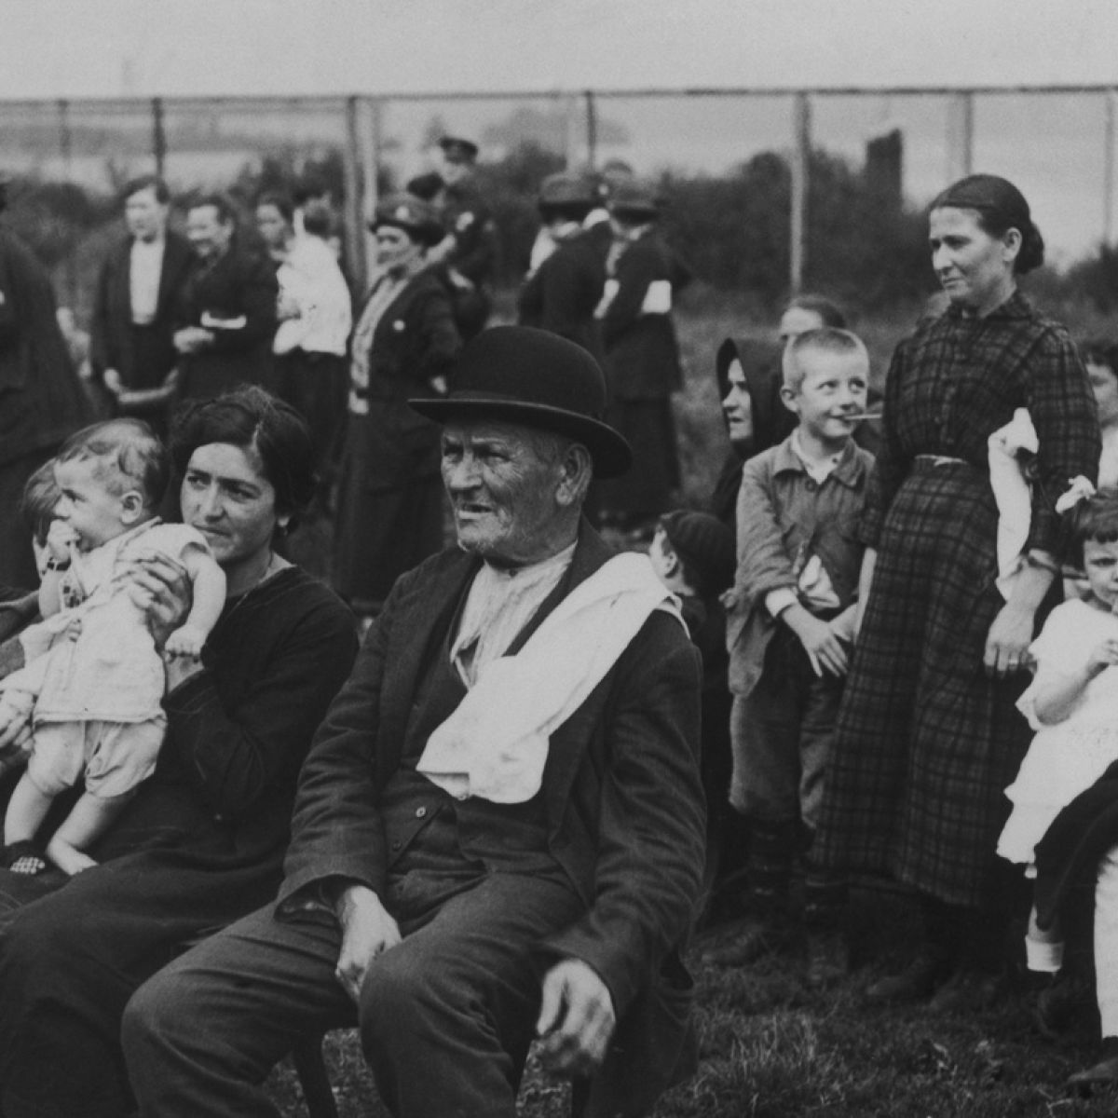
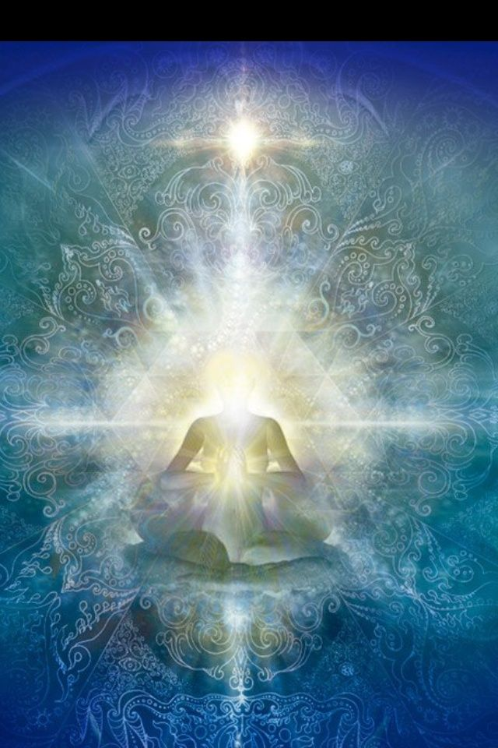
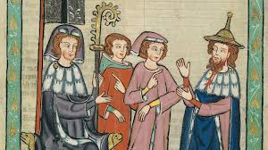
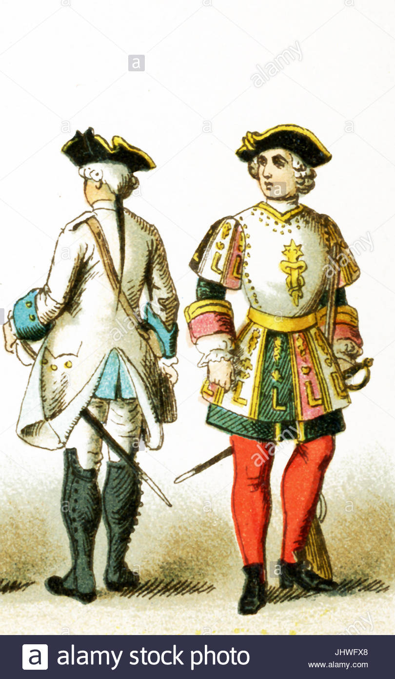
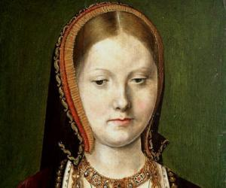
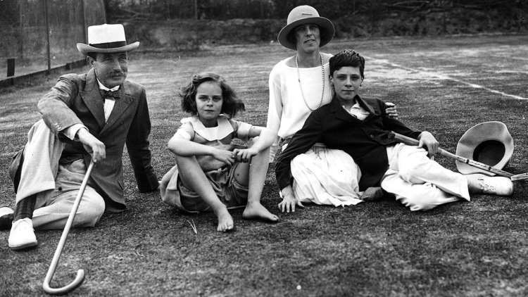
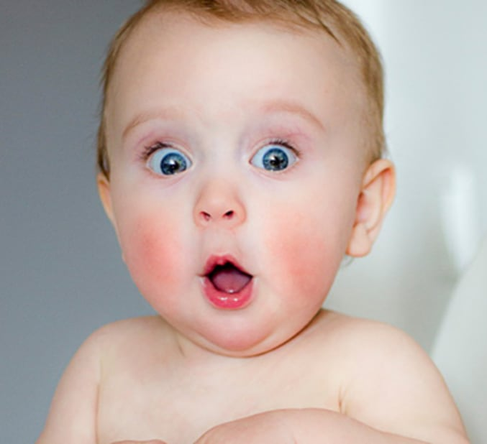
Evolution of me
V1.0
V2.0
V3.0
………………
Pure
Spirit

Slide 3
Spirits’ Book – question 166
166. How can a soul that has not reached perfection during corporeal life achieve purification?
“By experiencing the trial of a new existence.”

Slide 4
Spirits’ Book – question 167
167. What is the purpose of reincarnation?
“Atonement and the progressive betterment of humankind. Without this, where would its justice lie?”

Slide 5
Spirits’ Book – Question 168
168. Is there a limited number of corporeal lives, or does a spirit continue to reincarnate itself forever?
“With each new existence, a spirit takes a step forward in the path of progress. When it sheds all its impurities, the spirit no longer needs the trials of corporeal life.”

Slide 6
True or False
What does it mean to reincarnate?
It means to be born again, in a new physical body (born as a baby).

Slide 7
True or False
What happens when we reincarnate?
Our spirit forgets its previous existences, starts a new existence and continues to progress.

Slide 8
Divine Justice
If reincarnation didn’t exist, there would be no Divine justice.
Why?
God would have then created individuals physically, intellectually and socially different.
Each spirit was created simple and ignorant; all working towards perfection. Spirits were originated ignorant and without experience, but acquiring, little by little, the knowledge which they lack, by passing through the different phases of human life.

Slide 9
True or False
Our actions from past influenced our present life
Our past existences and choices defined our present life.
Therefore our own actions from the present is defining our __________

Slide 10
True or False
If we are smart enough or loving enough, we can achieve perfection (become angels) in one incarnation
False
It depends on the spirits themselves to go faster or slower, but this can’t happen in only one existence because evolution happens little by little.
Spirits reach the goal more or less quickly depending on the strength of their desire and the degree of their submission to the will of God.

Slide 11
True or False
Sometimes it is part of our spiritual plan to do evil. That is why we have ‘The Devil’
False
No one is born again with the objective of doing evil, but always with the goal of doing good.
God has not created any spirits bad; He has created them simple and ignorant. But the spirit can always choose to do good or bad through free-will.

Slide 12
True or False
What happens when return to the spiritual world?
We become angels
False
Once we disincarnate, our circumstances in the spiritual world will vary according to what we do here; if we did good or bad things.

Slide 13
We do not move backwards, just forwards or we may choose remain in the same place
Spiritual Evolution:
Spirits may remain stationary, but they never go back; those who are rebellious are punished by not advancing, and by having to recommence their misused existences under the conditions suited to their nature.

Slide 14
True or false
Reincarnation is a very important opportunity and we plan before reincarnating
The goal is to learn to love, to develop our intelligence.
And before reincarnating, we plan to have the opportunities to make amendments and to improve our moral values.

