Slide 1
The hairdresser that did not believe in God
STORY

Slide 2
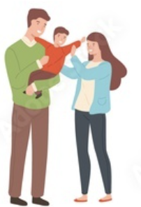
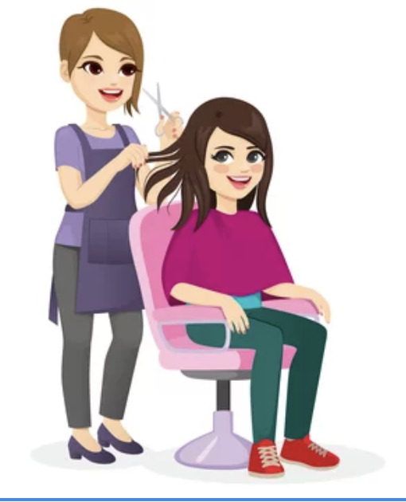
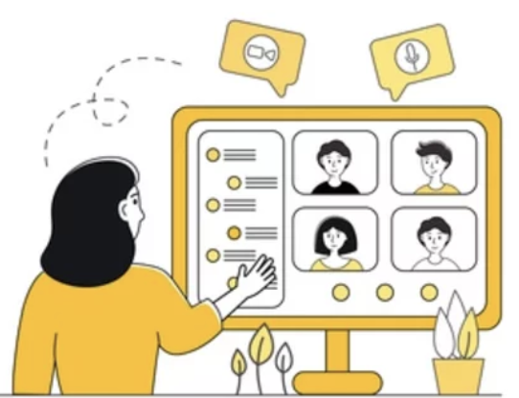
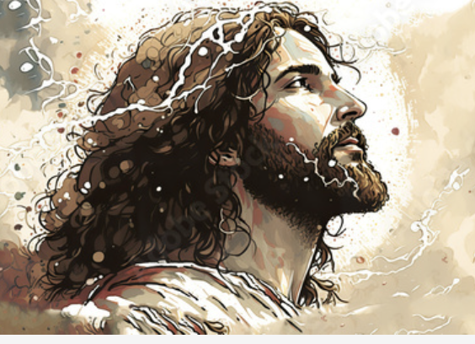
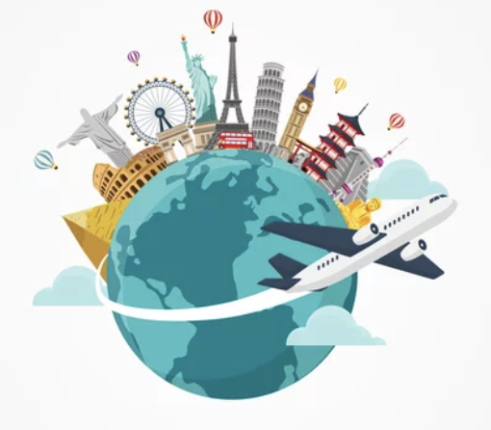

Slide 3
You know what? I don't believe God exists.
Why not?

Slide 4
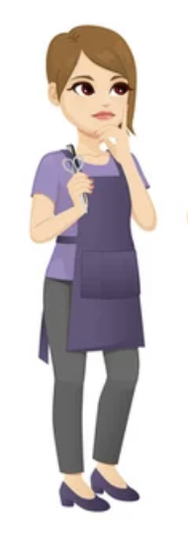
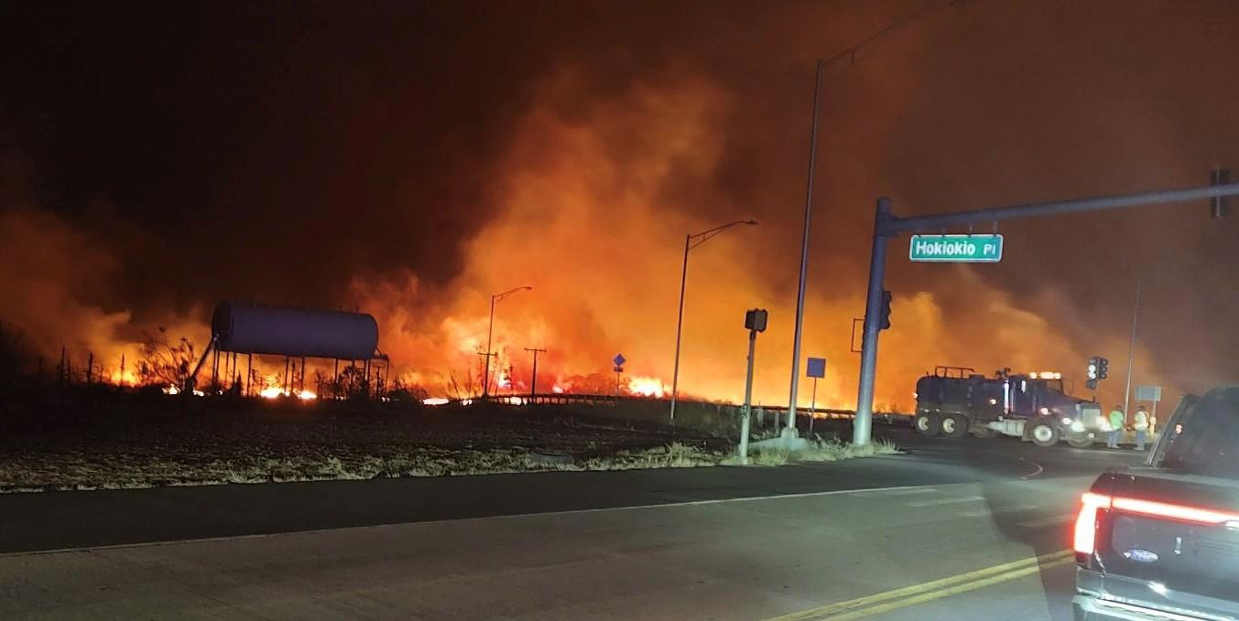
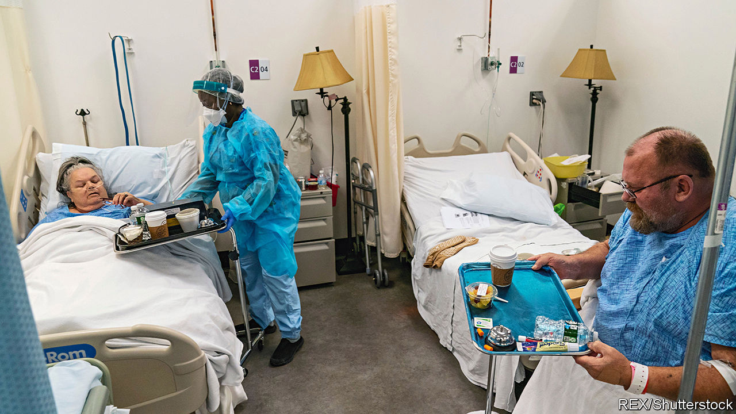
Alright. If God really existed, there wouldn't be so many sick people, so many abandoned children, and so much suffering in the world. Look what happened in Lahaina Maui. The fire killed people and destroyed so many homes! It is horrible. If God existed, there would be neither suffering nor pain. I can't imagine a loving God who would allow all of these things.

Slide 5
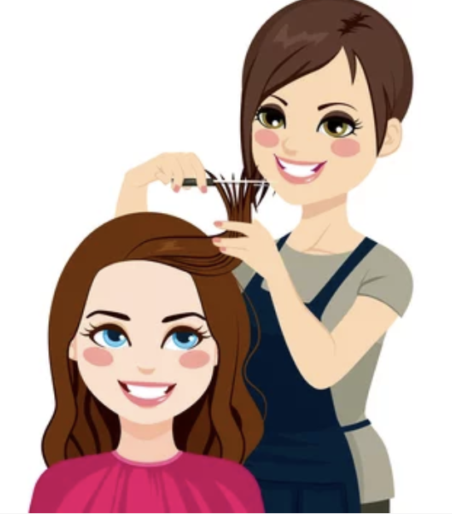

Slide 6
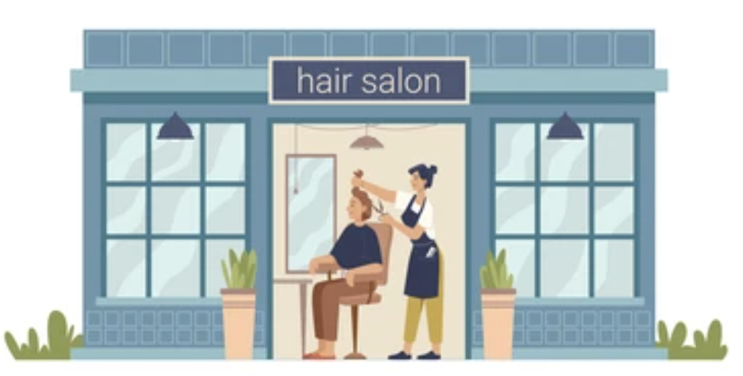
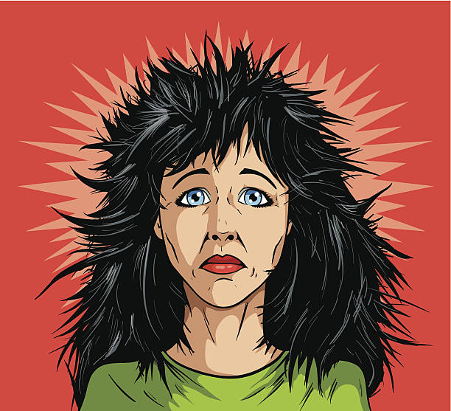

Slide 7
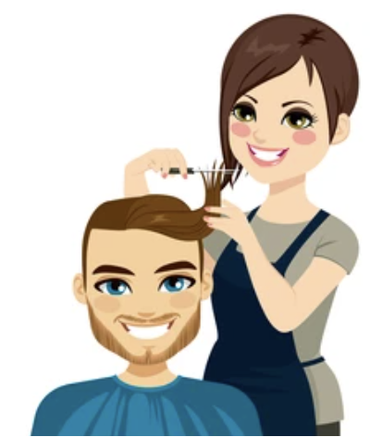
You know what? Hairdressers do not exist!

Slide 8
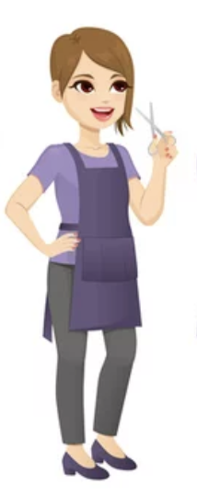
If hairdressers existed, there wouldn't be people with dirty and unkempt hair like the woman outside. There are thousands of people with messy hair just like her. Therefore, hairdressers don't exist.
How come? I'm right here in front of you, and I just worked on your hair

Slide 9
Well, hairdressers do exist, but not everyone wants to have a haircut. It's a choice; we can't force anyone to seek out our help.

Slide 10
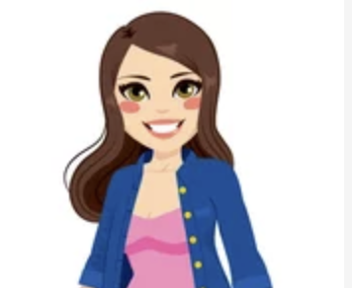
EXACTLY! That's the point! God, too, DOES exist! But people choose not to look to God for help and wisdom; that is why there is so much pain and suffering in the world.

