Slide 1
“To live, to die, these are natural things. But to die, truly die, we don’t die”
Kids and Youth - Spiritist Society of San Diego

Slide 2
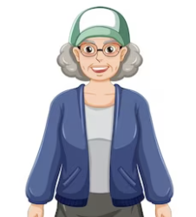
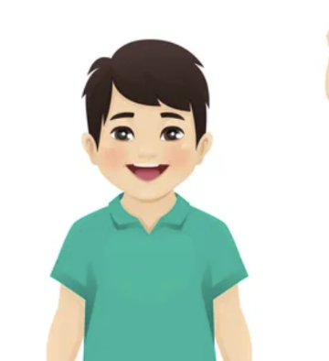
The story of Andre and aunt Ana

Slide 3
Today, we are going to talk about Andre and his aunt Ana story.
Andre loved his aunt very much and would visit her every weekend. His aunt had a special fondness for Andre because she was his mother's oldest sister and also much older than his mother.
Andre was like a grandson to her.

Slide 4
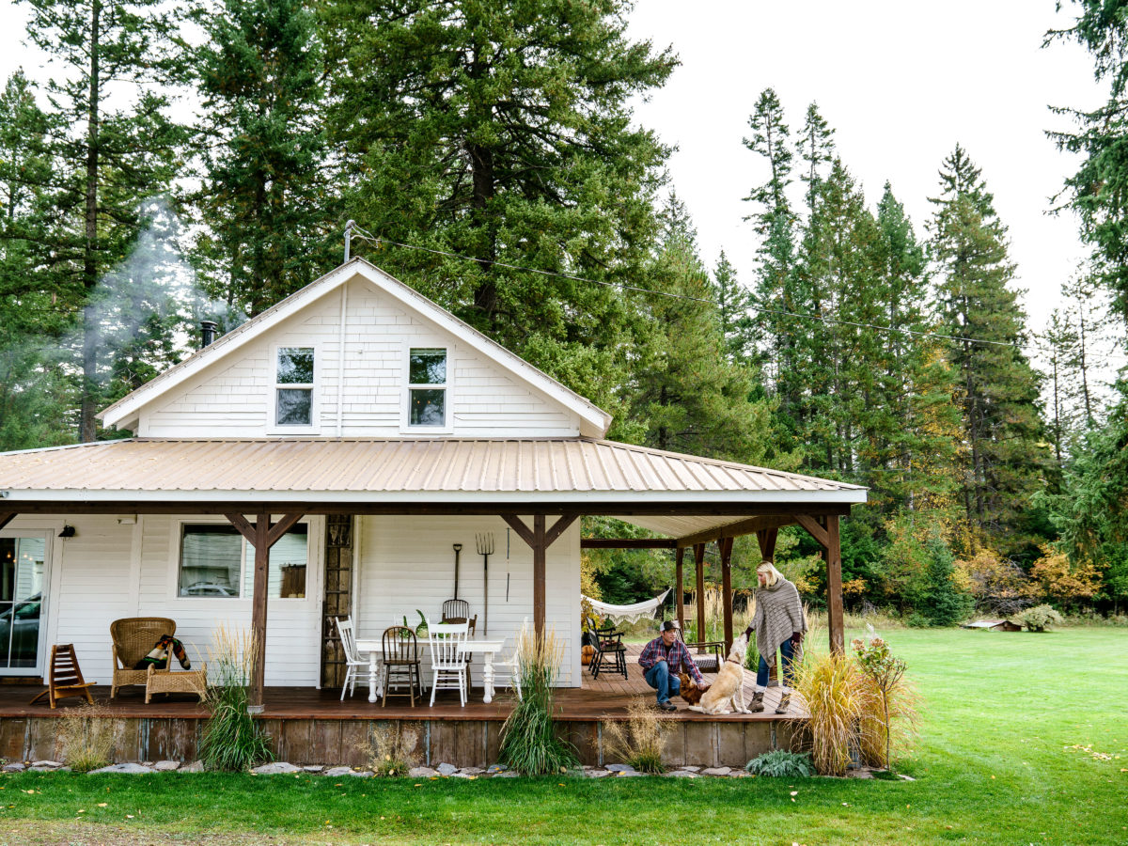
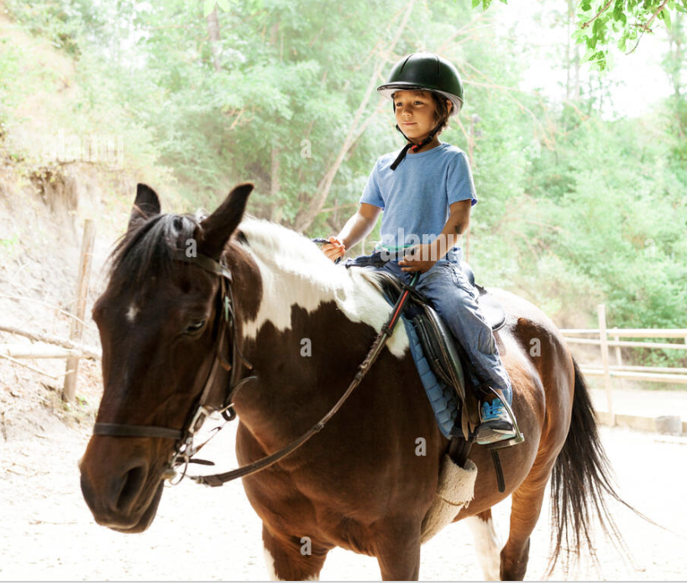
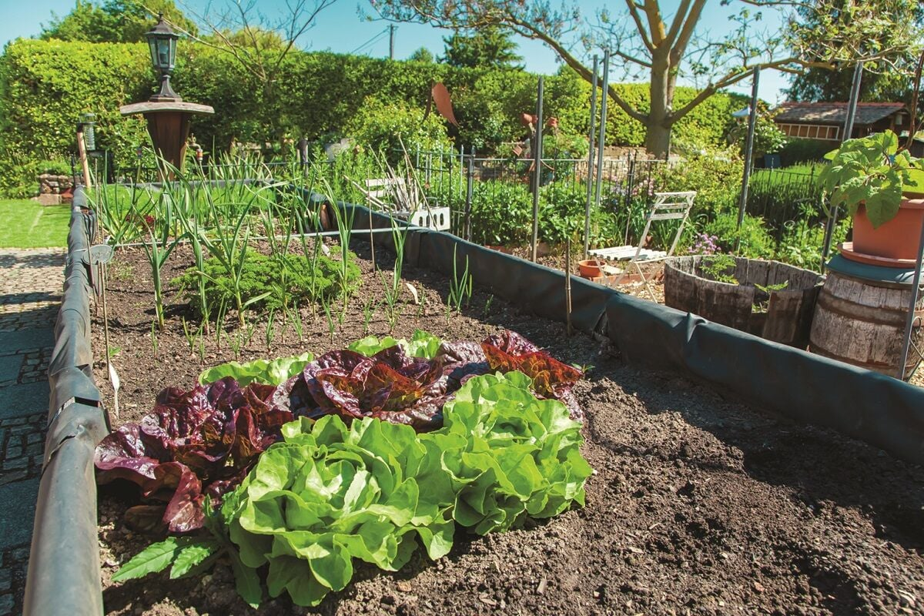
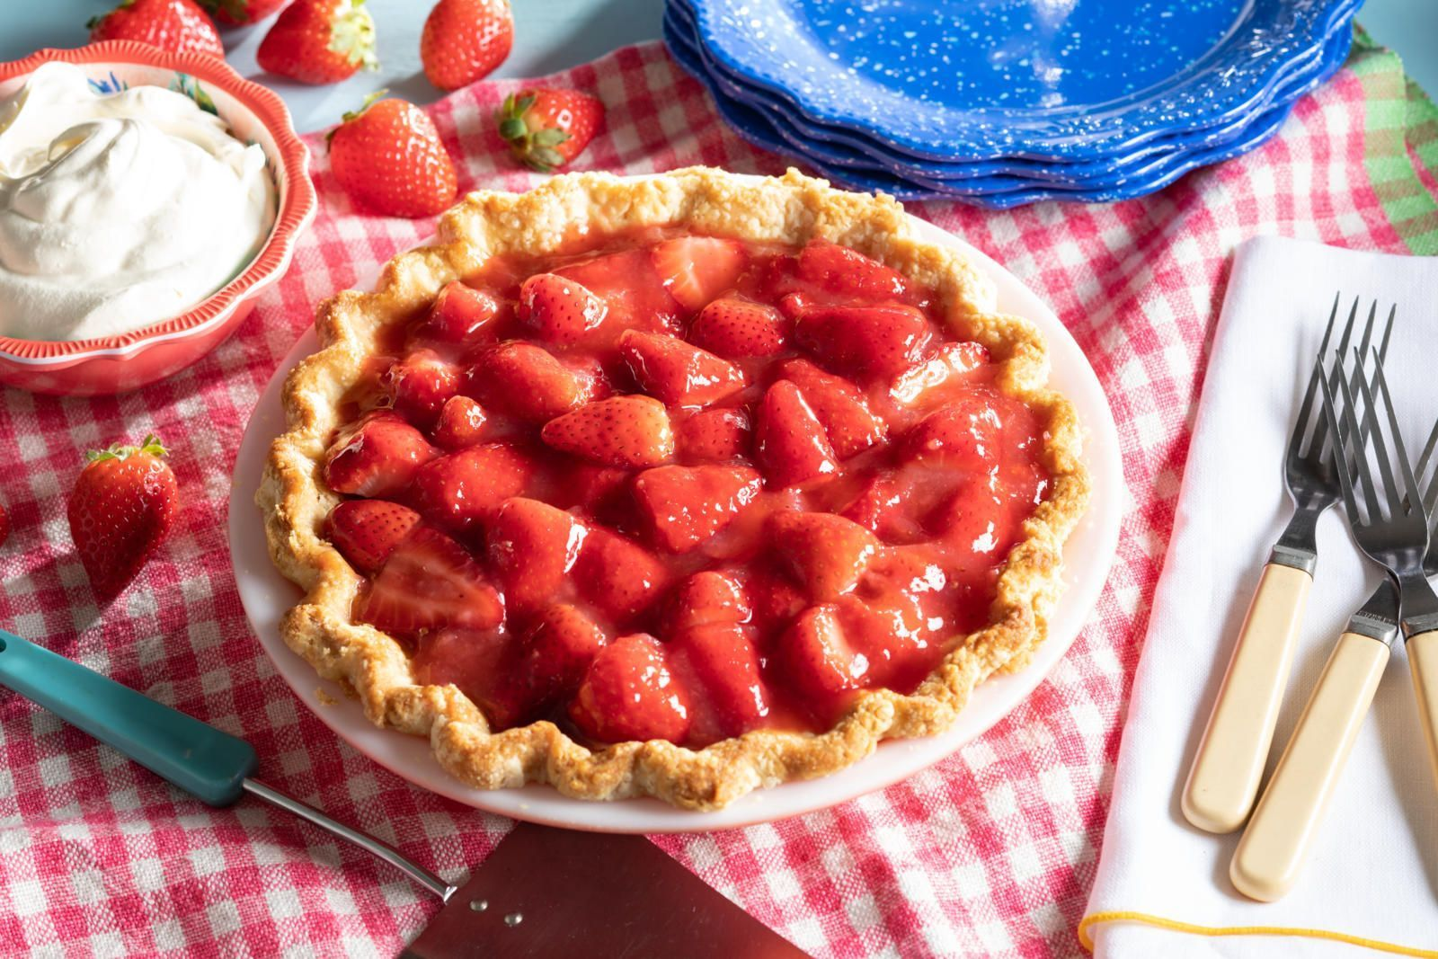
Notes:
Andre used to go to his Aunt Ana's house a lot. Ana had a garden, and Andre always helped her in the garden, and his aunt would make wonderful treats with the fruits they both harvested from the garden.
Her house was loaded with fun! He loved to ride horses and play with the animals in her aunt little farm

Slide 5
Andre used to go to his Aunt Ana's house a lot. Ana had a garden, and Andre always helped her in the garden, and his aunt would make wonderful treats with the fruits they both harvested from the garden.
Her house was loaded with fun! He loved to ride horses and play with the animals in her aunt little farm

Slide 6
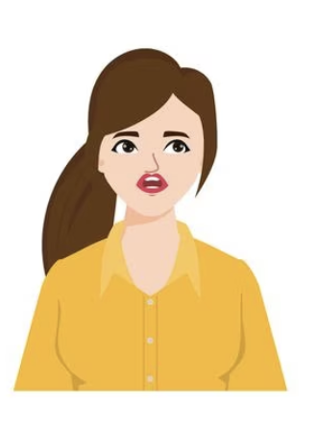
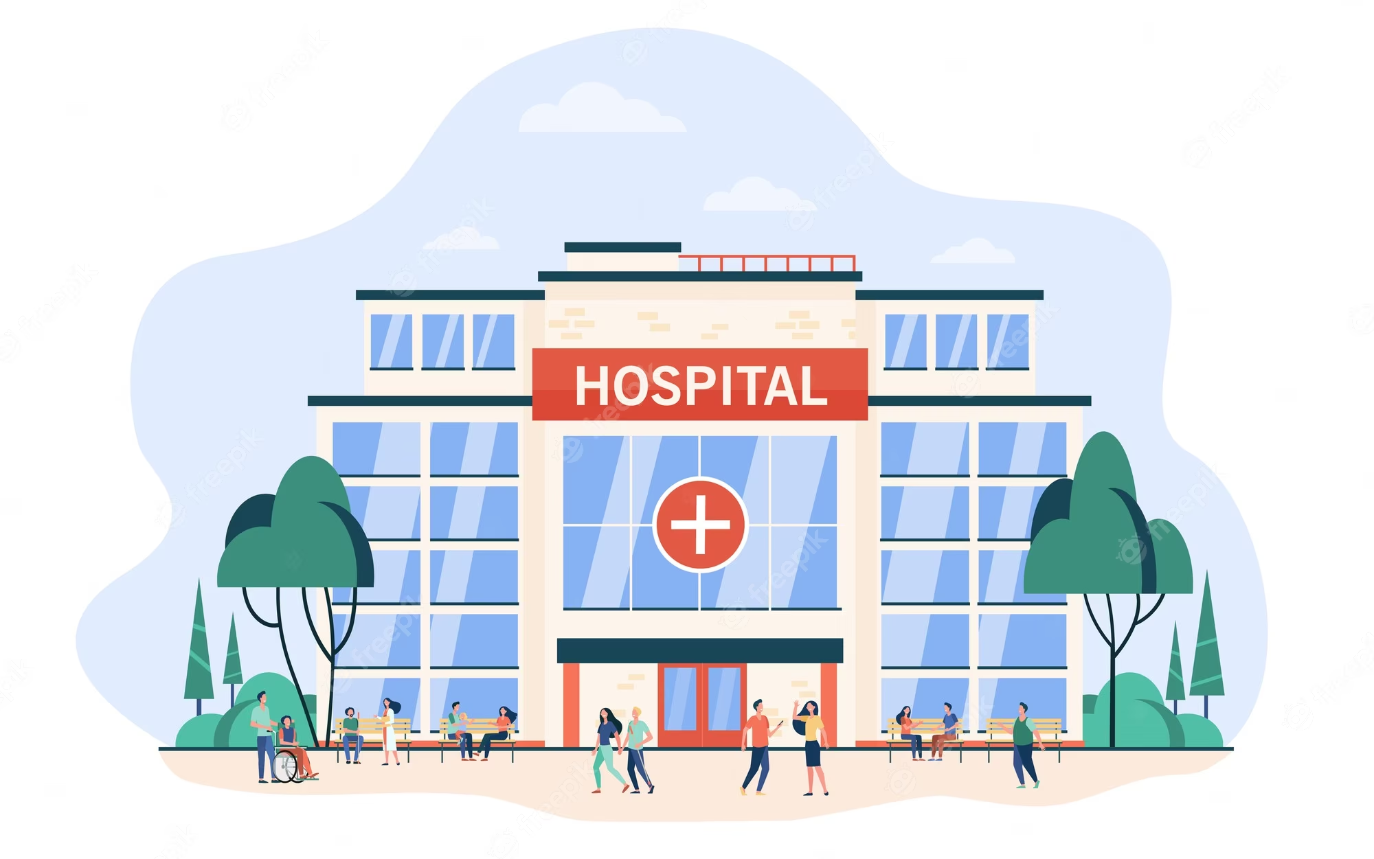
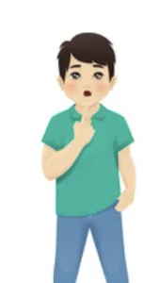
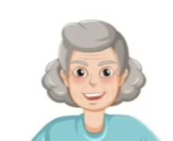

Slide 7
One day, his mother came home looking a bit shaken and said, 'Andre, your aunt had to go to the hospital. She fell really ill and we cannot visit her for a while”

Slide 8
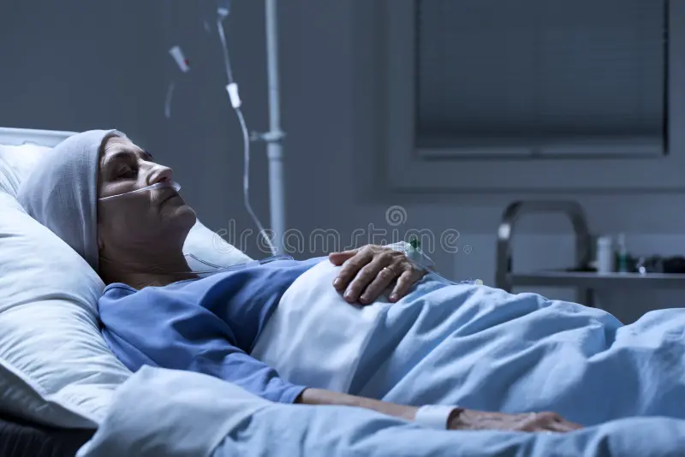
Notes:
Turns out, what aunt Ana had was really grave
Doctors said she was really sick

Slide 9
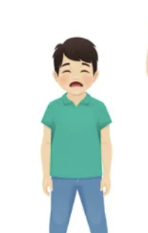
Andre got really worried about aunt Ana:
“Mom, is she going to be alright?
Mom said
“Doctors are saying what she is really sick. I am so sorry Andre, but aunt Ana is really really sick”
His mom starting praying with him so that aunt Ana would feel better and whatever was best would happen to her.

Slide 10
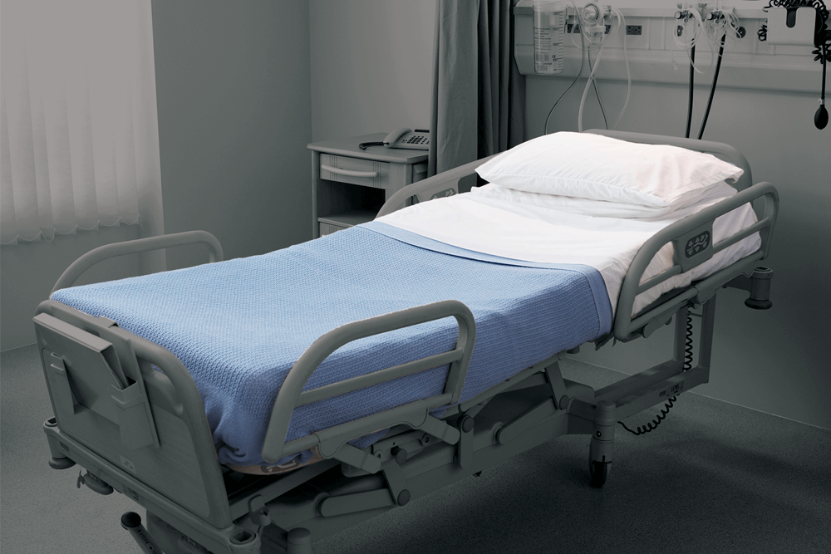
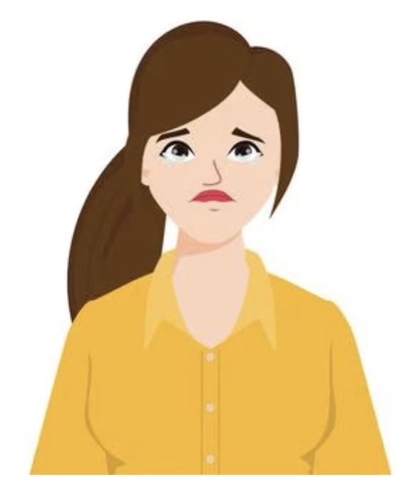
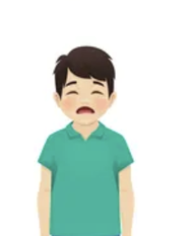
Notes:
Few days later, aunt Ana got worse!
She passed away within few days and that was devastating to Andre
He could not understand why that happened.

Slide 11
Few days later, his mom said “Andre, aunt Ana is no longer with us; she has returned to the spiritual world.'"

Slide 12
Why God did this to aunt Ana! Aunt Ana is a good person! And now she is gone! I will never see her again!

Slide 13
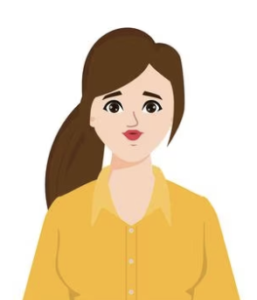
Well, we believe it does not work like that son.
When we die, it is our body that dies. Aunt Ana did not cease to exist. We are immortals. Which means our body dies, but our spirit continues.

Slide 14
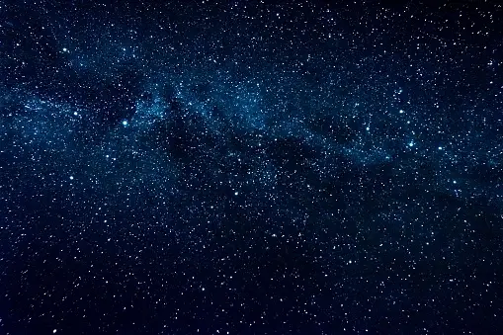
The sun exists even though we cannot see it at night. The same with the stars, we cannot see them during the day, but they are still there.
Notes:
The sun exists even though we cannot see it at night. The same with the stars, we cannot see them during the day, but they are still there.

Slide 15
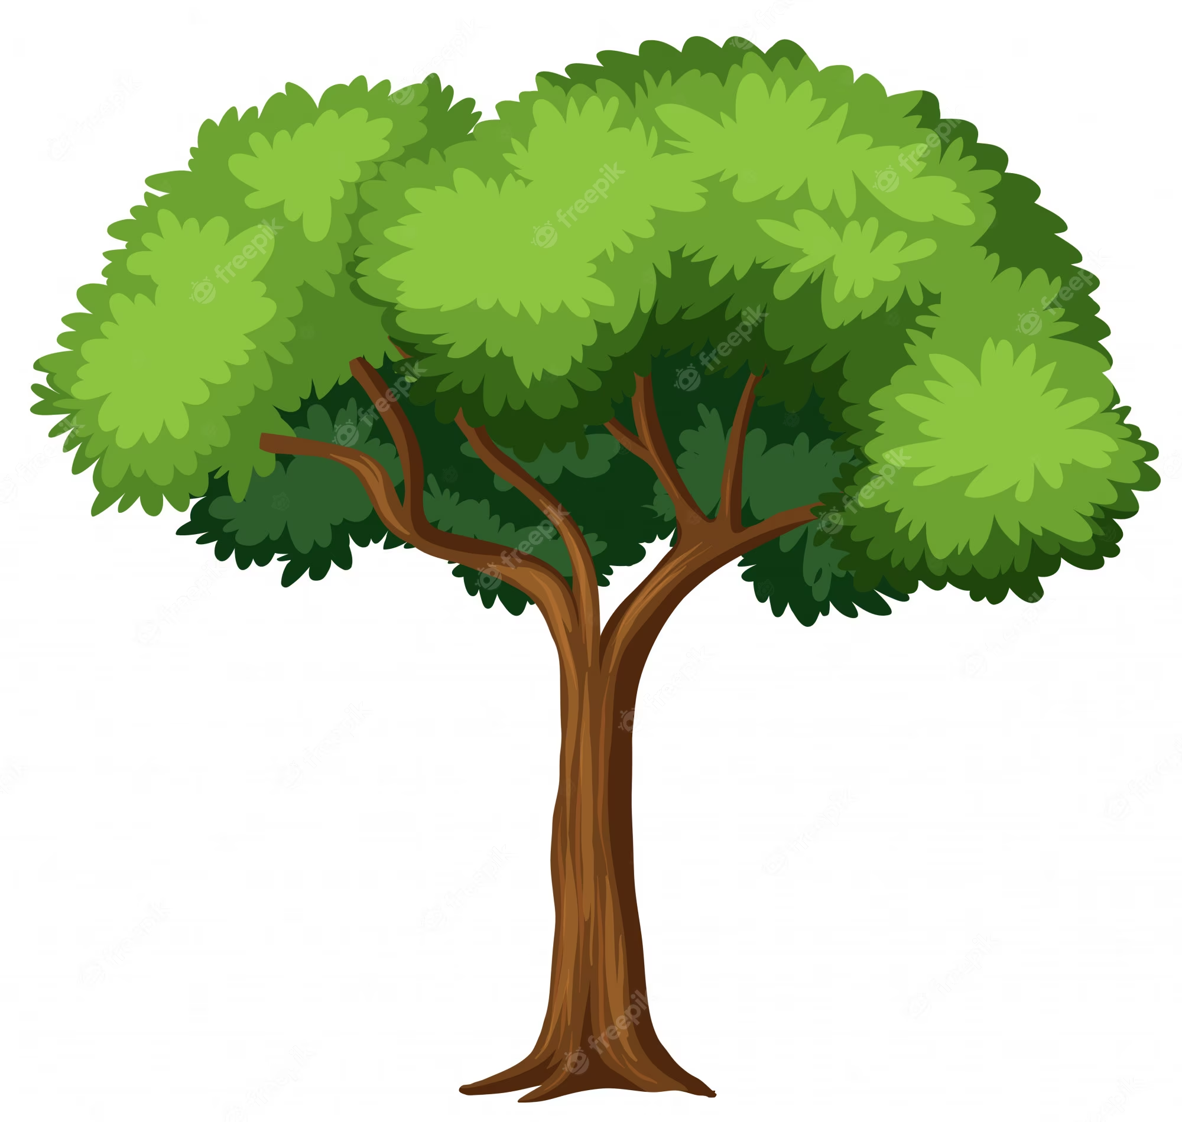
Did the seed just disappeared? The seed transformed into this big tree. It did not disappeared, it is not this tree

Slide 16
Well, I am sad too, but I know she was really sick and that was causing her a lot of pain!
She told me she lived a good life and she was ready to be with our mom and dad. And she really loves us and would be watching over us and praying for us.

Slide 17
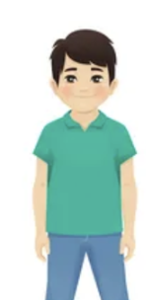
Wait! Do you mean I will see aunt Ana again?
And that she can see us now?

Slide 18
I am not sure about right now, because it takes a little bit for us to recover in the spiritual world. But she will be able to see us, and one day, to visit us.
We continue being connected, in prayer, in thoughts. Our love connections never die.
One day we will see and be with her again, just like we will see grandma and grandpa again!

Slide 19
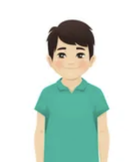
That was a relief to Andre!
He was feeling much better learning that life does not cease.
And all the people he loves will never truly die!
It just means we live in different dimensions, temporarily.
His mom took a book and started reading to Andre. Let’s see what it says?

