Slide 1
Happy New Year!
YOUTH and KIDS PROGRAM

Slide 2
Warm up game
Real or AI picture?
https://www.whichfaceisreal.com/

Slide 3
What comes to mind when you think about the New Year?
Many people look at the new year as a new beginning. It's a chance to turn over a new leaf and make positive changes in your life.

Slide 5
What does the Bible say about New Year’s resolutions?
Jesus certainly encourages us to examine our lives and resolve to change them if necessary (although not just at the beginning of a new year). The Psalmist, for example, made a resolution to keep his speech pure: “I have planned no evil; my mouth has not transgressed” (Psalm 17:3). The ultimate goal is for us to become a better person.
Why do so many of our resolutions fail? Sometimes it’s simply because they aren’t realistic. Instead, they’re only wishful thinking, with no way to make them actually happen. For example, you might resolve to make a million dollars this year, but if you don’t have any way to earn it, it probably isn’t going to happen.
Other resolutions fail because we aren’t willing to make the sacrifices necessary to reach them.

Slide 6
Should I keep trying?
What was the question the singer kept asking himself over and over again in the song? Is that a good question to ask yourself? Why or why not?
Have YOU ever doubted what you believed (about a person or situation)? What happened?
What do you usually do when people doubt you or disagree with you?

Slide 7
Asking “Am I wrong?” is a hard and honest question. It can be scary. But why should we do it from time to time?
Can you think of a few examples when asking that question fits into life?

Slide 8
What if … About the song
Life has a way of throwing doubt after doubt at us. Those doubts cloud our judgment and can cause us to question our convictions, beliefs and resolutions
In the song we just heard, the singer was checking his convictions; was he wrong to think that he had a future with a certain individual. But the questions he asked himself can be applied to several other areas of life. In the end, as Christians, you and I must follow our convictions, even when others think we are wrong or disagree with us.

Slide 9
Sometimes, life can get confusing, and things that look real are really not real or good (Just like the game we played)
Well, Jesus gave us the perfect example to follow and that is especially important during this confusing times.

Slide 10
Qualities of a good person
Honest
Loving
Accountable
Responsible
Joyful
Good listener
Grateful

Slide 11
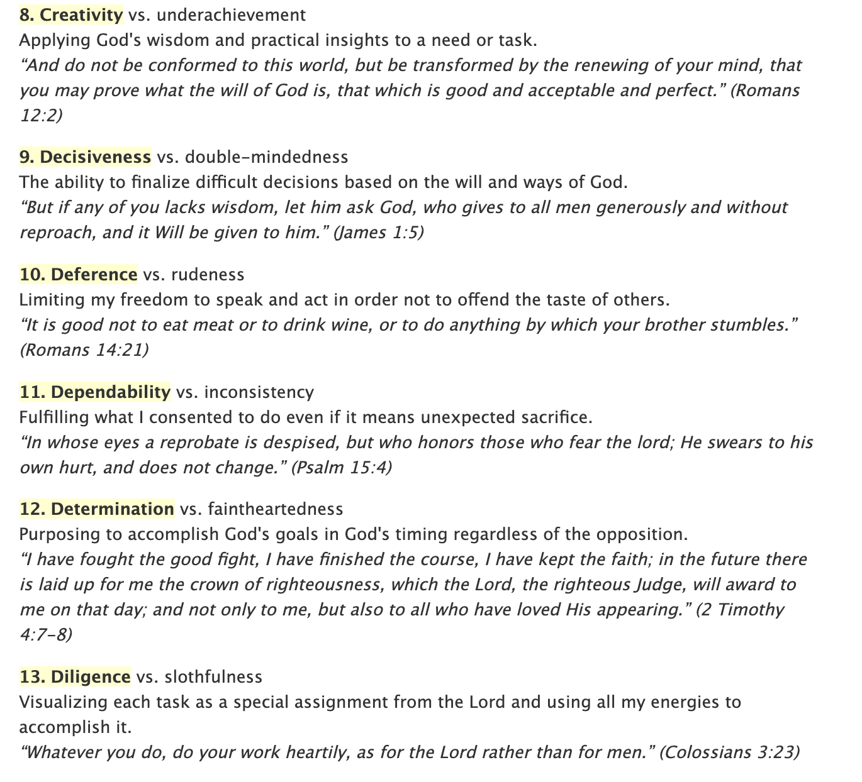
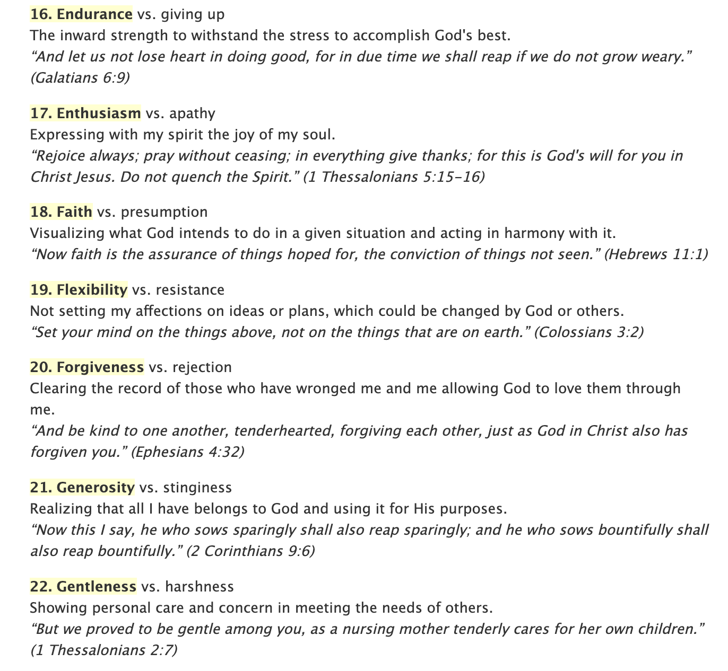
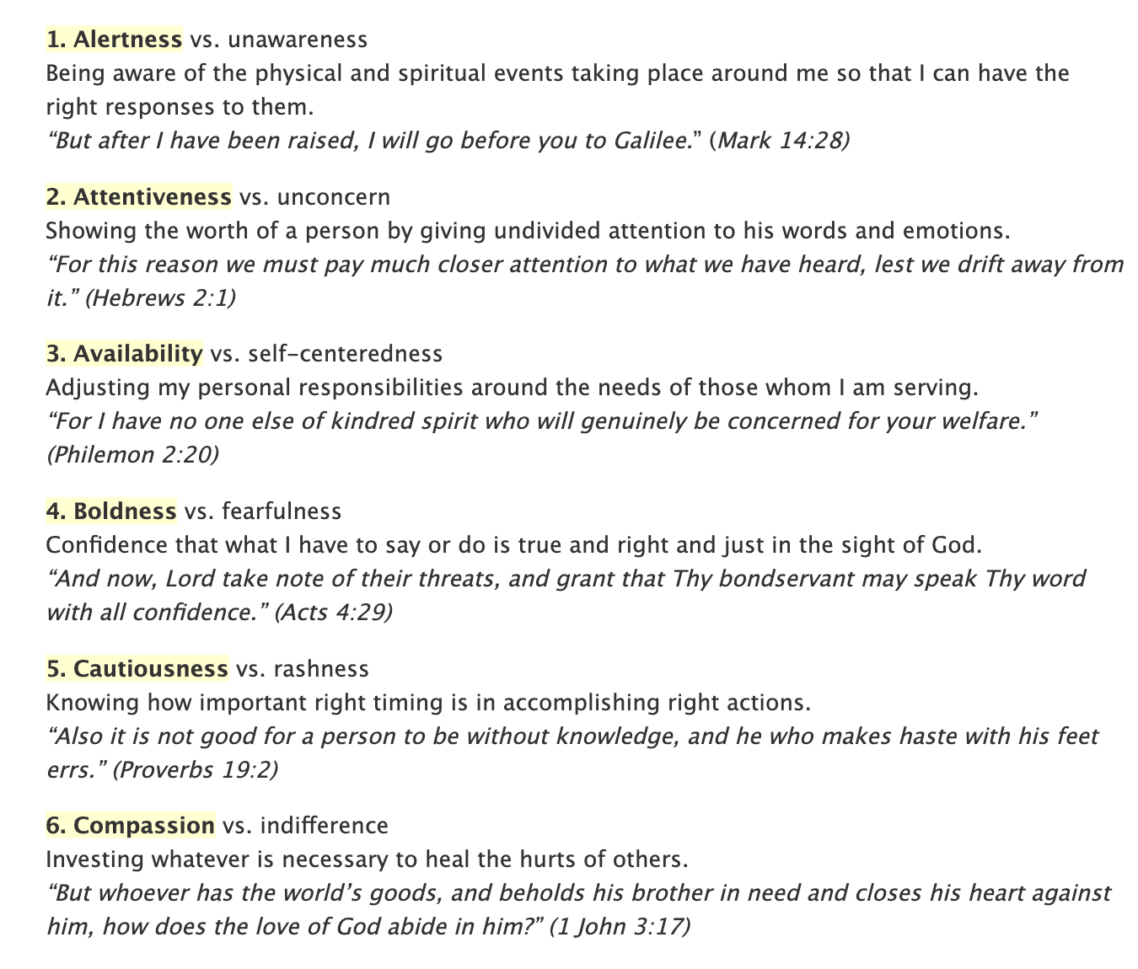
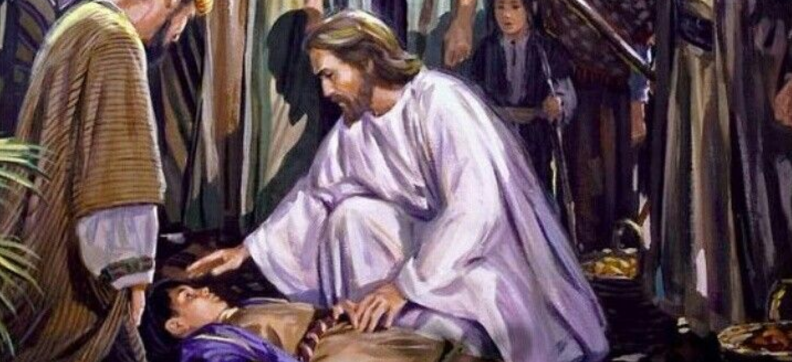

Slide 12
Some changes are harder than others, and we may even question ourselves. Hard questions are a very mature thing to do!
Begin the New Year by turning to Jesus Christ and inviting Him into our life. Ask for strength to keep your good resolutions But also ask the hard question! Ask for wisdom and courage to see and change our own faults too!

