Slide 1
REINCARNATION
AND THE LAW OF CAUSE AND EFFECT

Slide 2
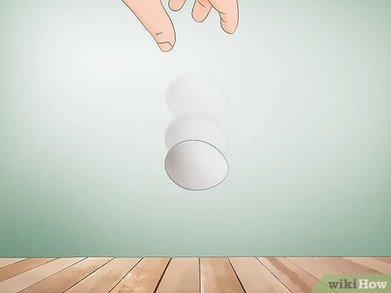
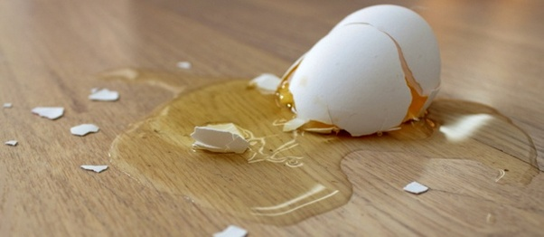
Recap: DIVINE LAWS
NATURAL LAWS = GOD’S LAWS
Gravity is just a “theory” !!!
EXISTS WETHER YOU BELIEVE OR NOT

Slide 3
GOD
SPIRIT
MATTER
LAW OF WORSHIP
LAW OF WORK
LAW OF REPRODUCTION
LAW OF PRESERVATION
LAW OF DESTRUCTION
LAW OF SOCIETY
LAW OF PROGRESS
LAW OF EQUALITY
LAW OF LIBERTY
LAW OF JUSTICE, LOVE AND CHARITY
UNIVERSAL LAW OF GRAVITATION
NEWTON’S LAW OF MOTION
THERMODYNAMICS
PLANETARY MOTION
ARCHIMEDES PRINCIPLE
PRINCIPLE OF NATURAL SELECTION
LAW OF CHEMISTRY AND MANY OTHERS

Slide 4
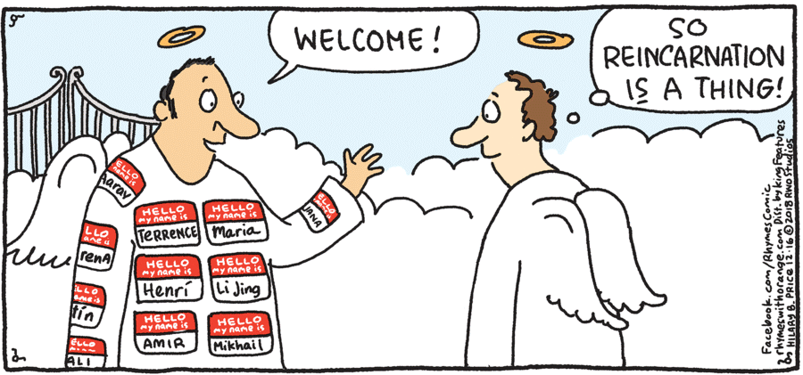
Today: REINCARNATION and Law of Cause and Effect
REINCARNATION IS A NATURAL LAW AND THEREFORE A DIVINE LAW

Slide 5
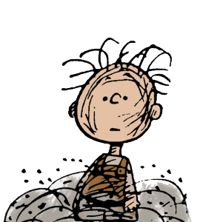
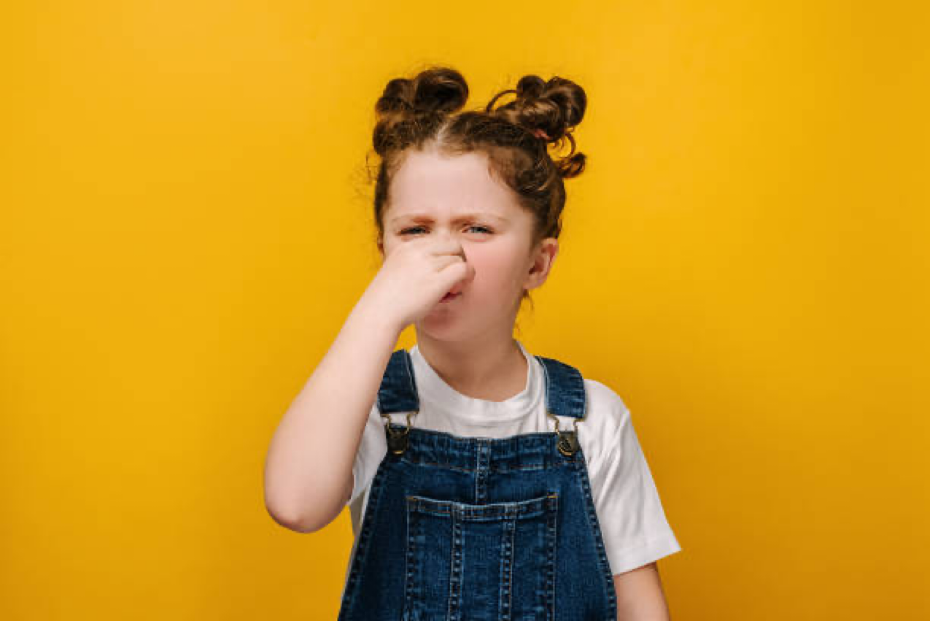
Recap Law of cause and effect: The law of cause and effect is a universal law which states that
every single action in the universe produces a reaction no matter what.
Cause: I do not take shower
Effect

Slide 6
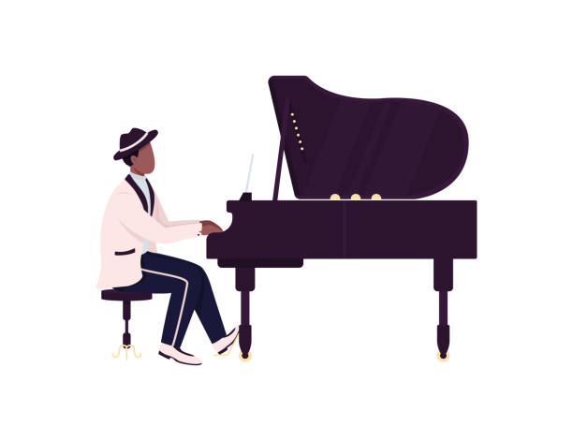
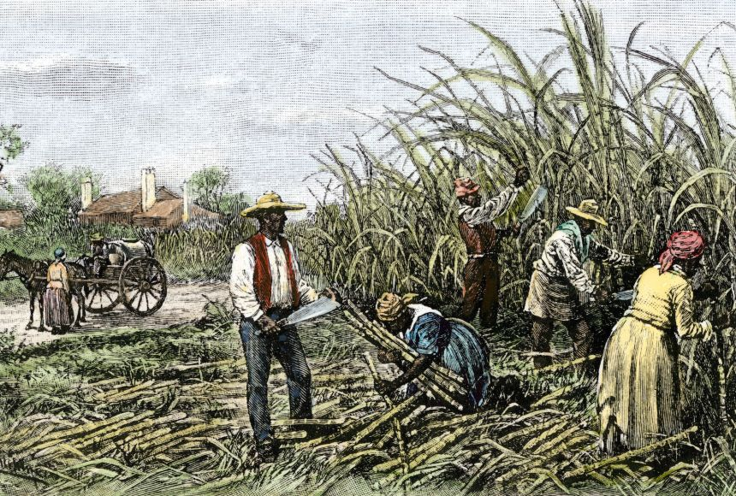
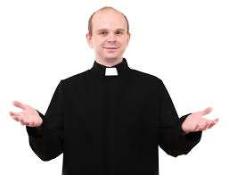
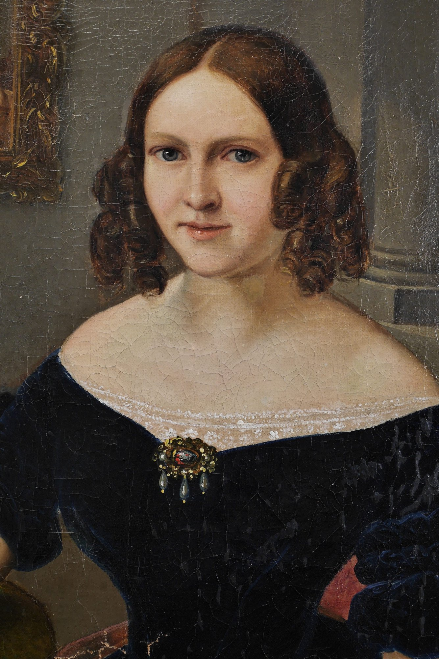
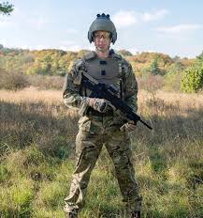
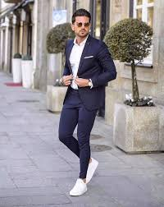
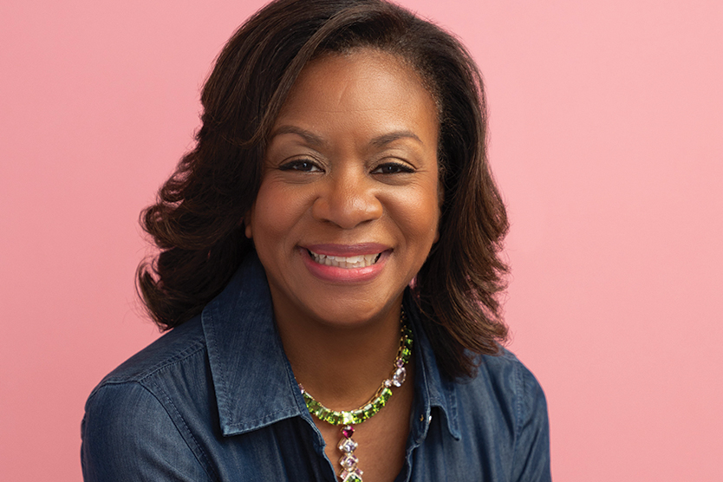
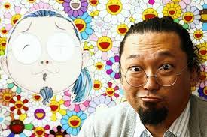
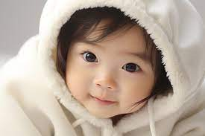
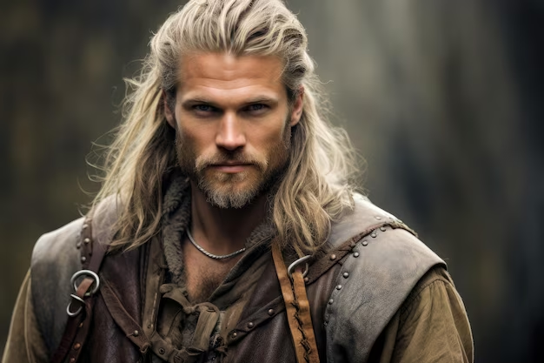
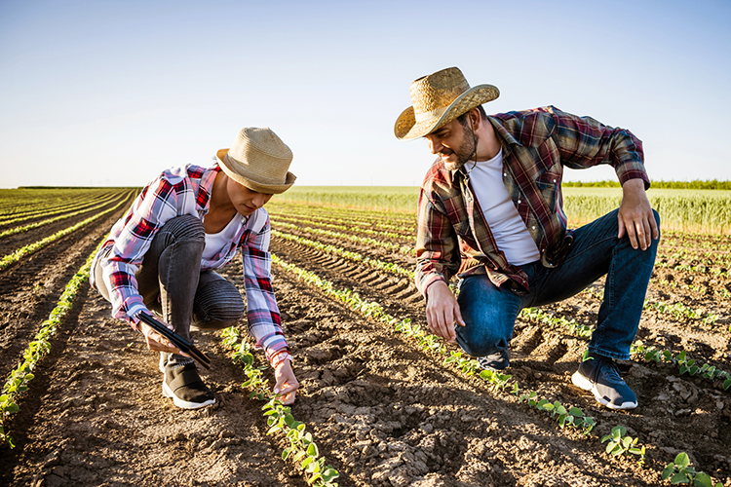
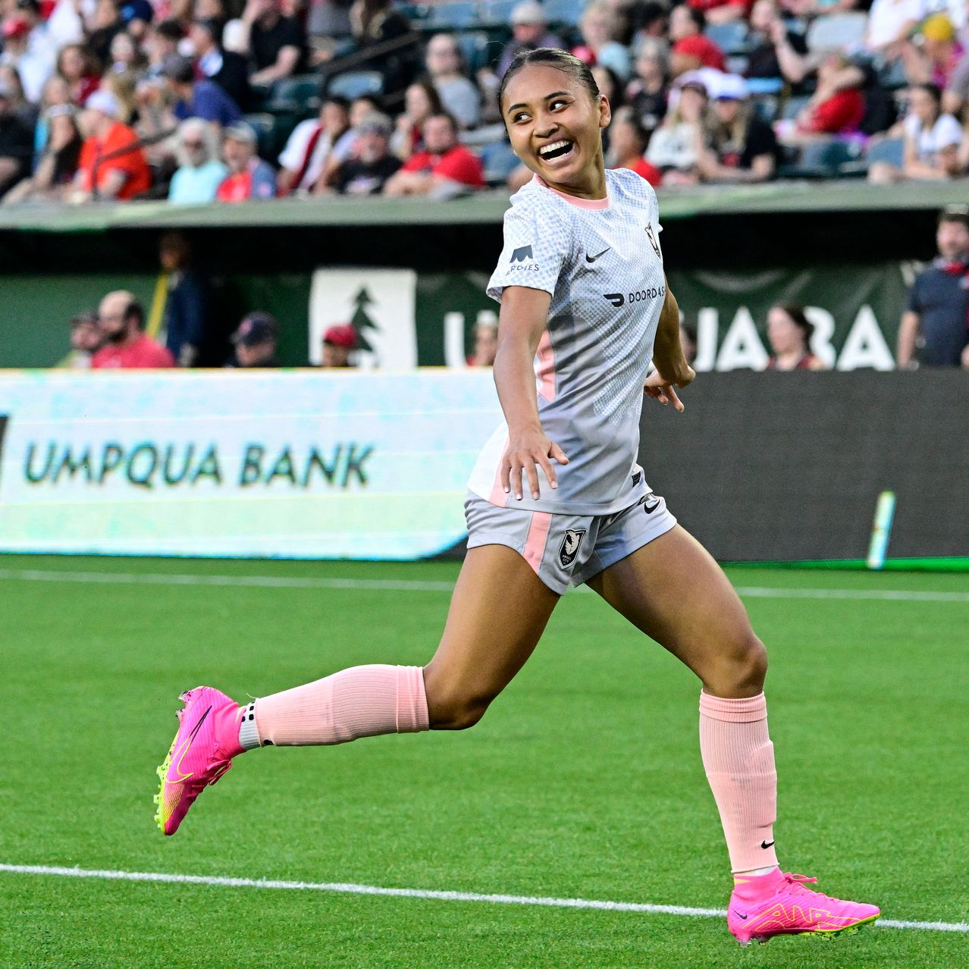
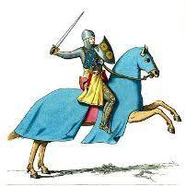
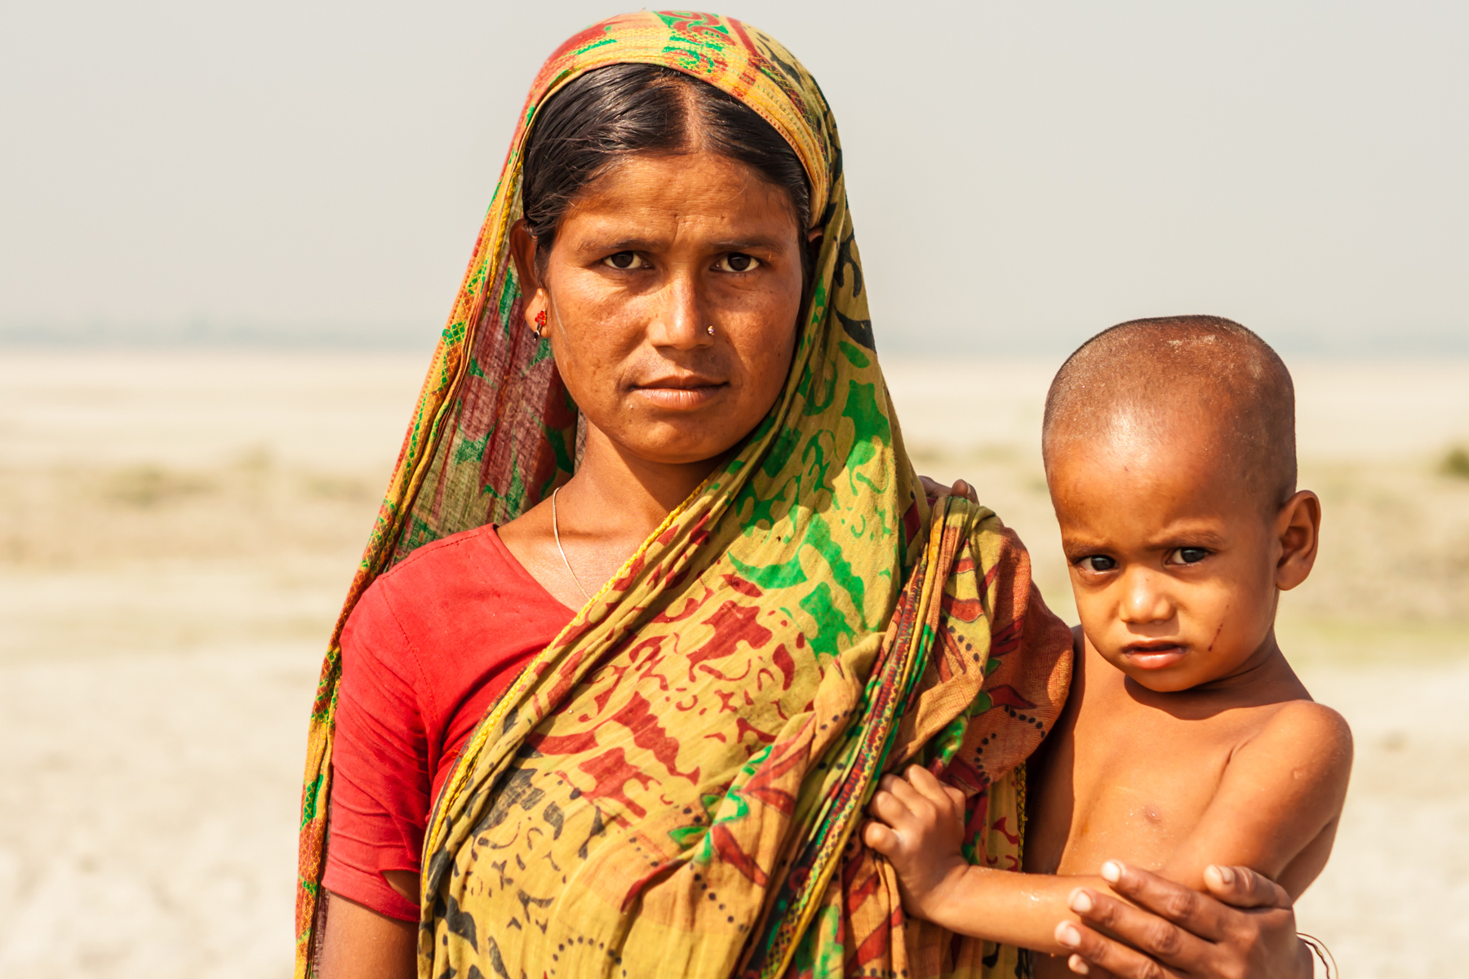
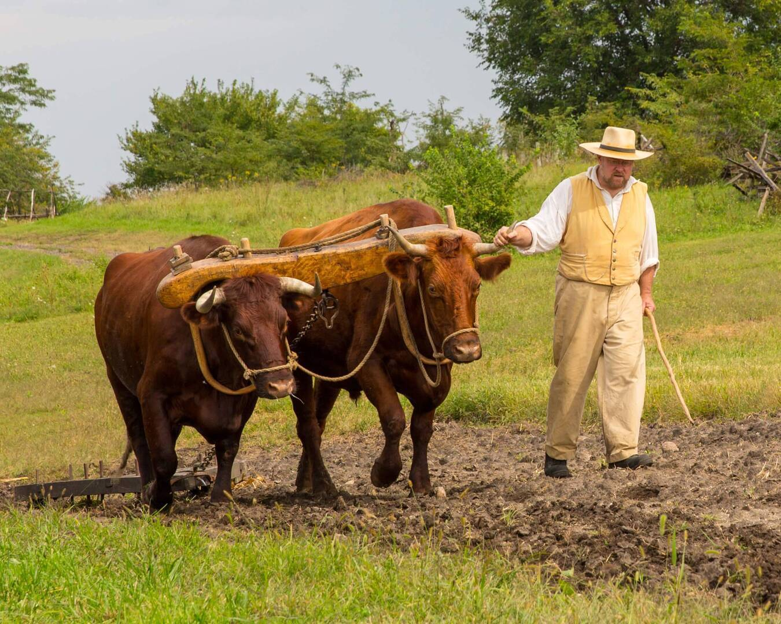

Slide 7
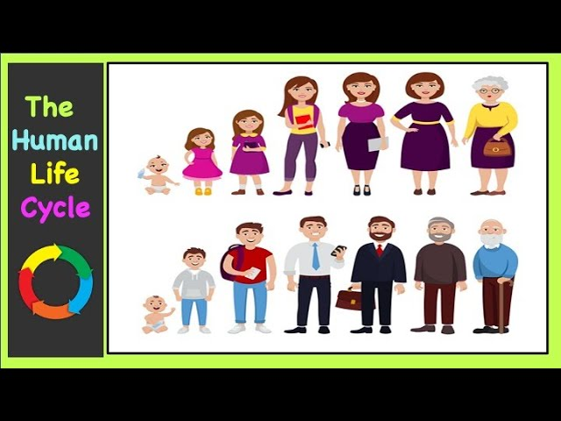
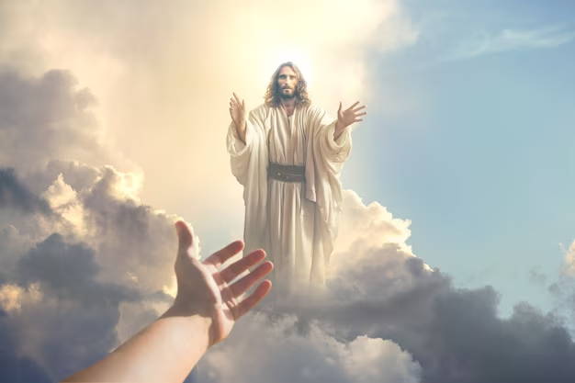
REINCARNATION
Opportunity to grow spiritually, intellectually, morally continuously
Opportunity to make ammendments
Opportunity to experience life differently from what we did in previous life
Continuously until we become pure spirits like our big brother …..
JESUS

Slide 9
BUT DOES REINCARNATION HAVE TO DO WITH LAW OF CAUSE AND EFFECT
The concept of cause and effect is closely linked to reincarnation. Spirits carry the consequences of their actions from one life to another, influencing the circumstances and challenges they face in subsequent incarnations.

Slide 10
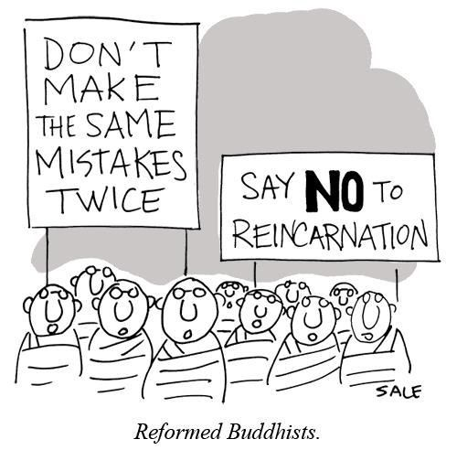
CHOICES (FREE WILL) MATTER MORE THAN WE MIGHT THINK
TOO MANY TIMES

Slide 11
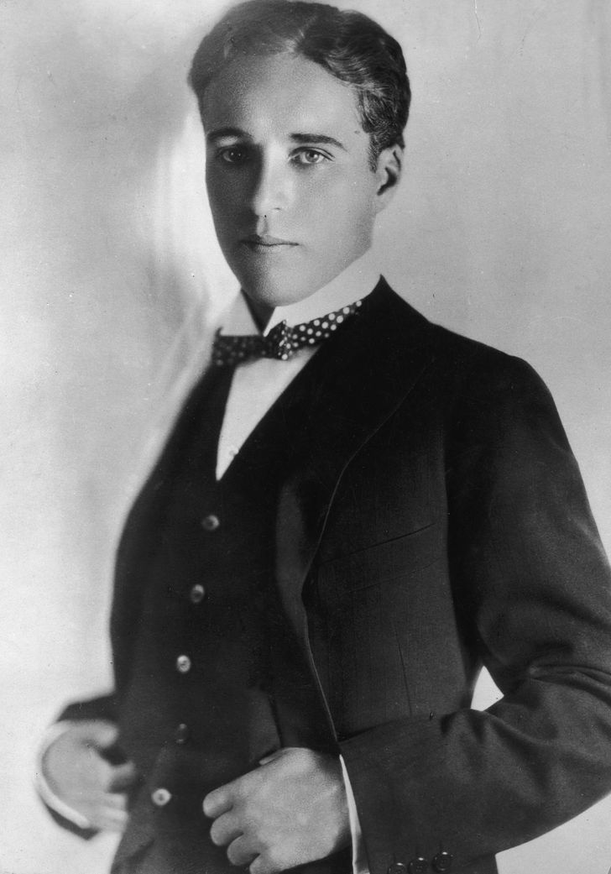
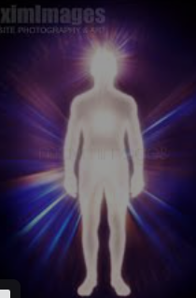
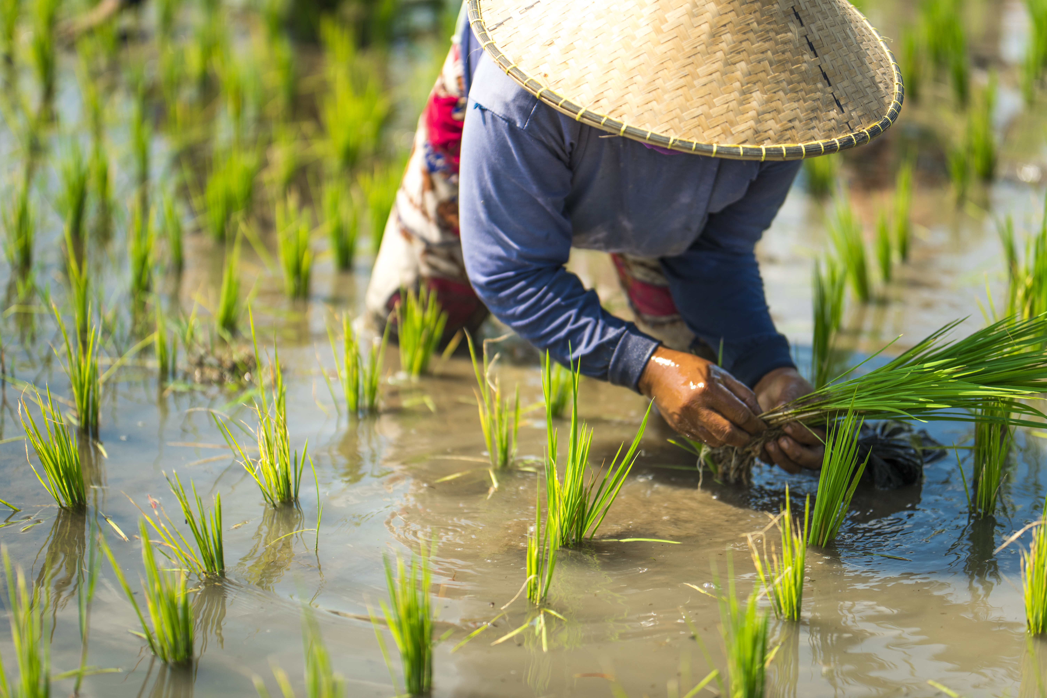
DIVINE JUSTICE
PAST LIFE
CURRENT LIFE
Chailai was born into a family of 15 in Bangkok.
Her family is engaged in rice cultivation, leading a sustainable and simple life.
However, when the crops yield poor results, Chailai's parents struggle to provide for themselves and their children. Frequently, Chailai finds herself dealing with their family landlord, who shows little respect for the difficulties her family is going through.
In a past life, Alex was a highly successful business executive known for his arrogance and a lack of consideration for others.

Slide 12
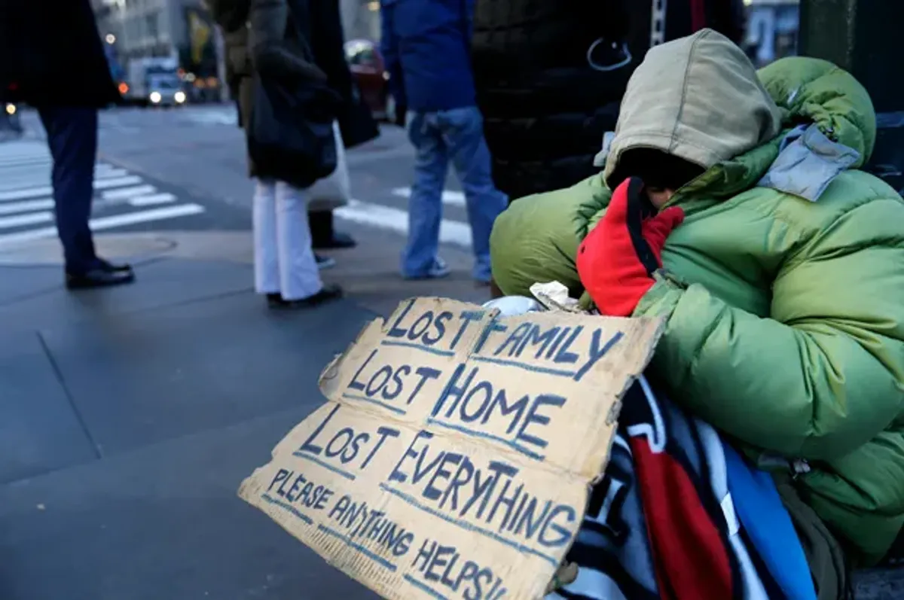
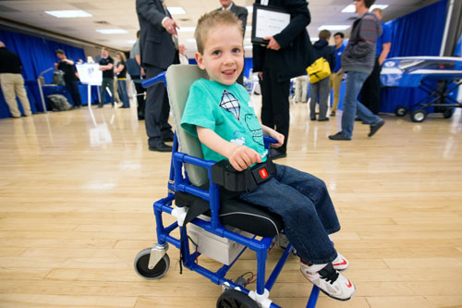
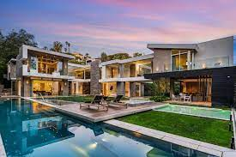
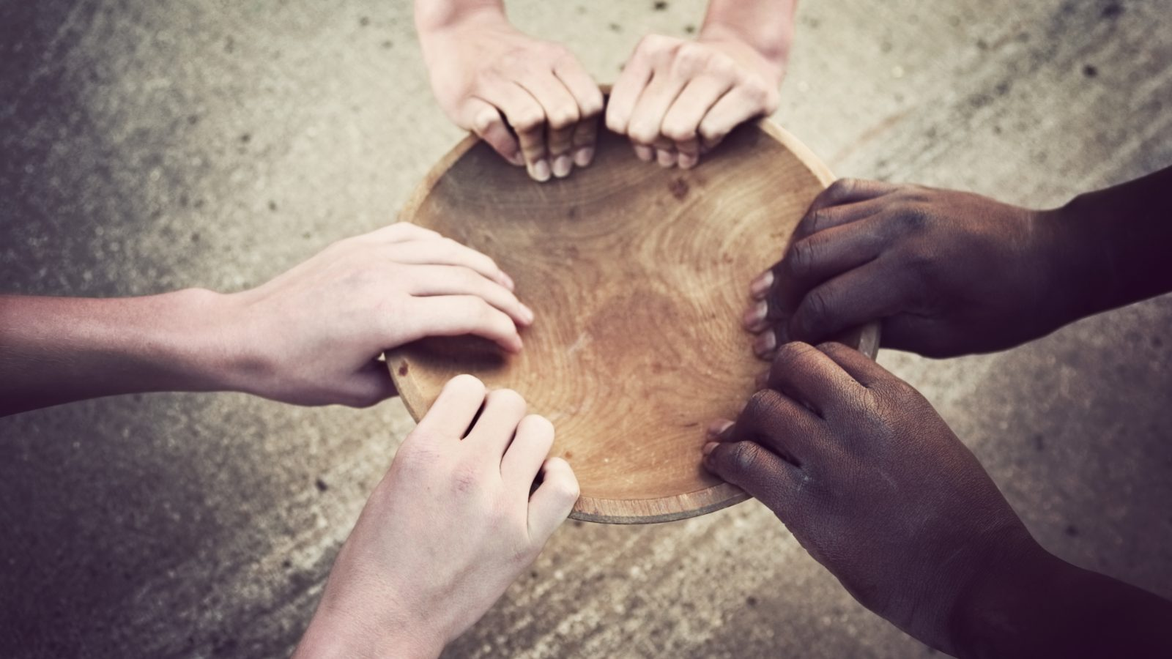
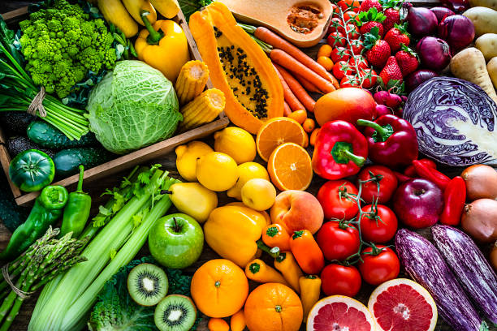
If you cannot find the cause in this life…
As servants of God, our role is to offer help and support

Slide 13
Matching game

Slide 14
Challenge
responsible virtue consequences back inevitable do treat imperfection joy good
All our actions bring _______________(1), which can be good or bad depending on what we do. Every ___________(2) of our soul leads to unpleasant and ________ (3) results, and every _______(4) brings _______(5) and rewards.
Each person is ____________(6) for their actions and will experience the outcomes of what they _______(7). Everything _______(8) or bad that we do comes _______(9) to us. That's why Jesus taught us to ______ (10) others the way we want to be treated.

